Slide 1

BERI’D ALIVE
GROUP NAME: Team9
MEMBERS:
William Bernstein-Cuevas : working on video game
Isaiah Adigun : working on video game
Gabriel Flemming : working on video game
Joosung Son : working on website
Vedkumar Patel : working on website

Slide 2
Table of content
What is the Game About?........................................................................3
Framework/Architecture………………………………………………………………………..4
Get Familiar With Our Game Website……………………………………………………..5
Home Page….………………………………………………………………………………………6
Log In/Create Account Page…………………………………………………………........7
Updates Page………………………………………………………………………………………8
Feedback Page…………………………………………………………………………………...9
Bug Report Page…………………………………………………………………………………10
Developer’s Introduction Page……………………………………………………………11
Compendium Page……………………………………………………………………………..12
Conclusion……………………………………………………………………………................…13

Slide 3
What is the Game About???????
Turn-Based RPG with fighting game mechanics
Modular battle system
Different levels, maps, puzzle-solving
Save-Load System
Story of the game

Slide 4
Framework/Architecture
Project divided into two disciplines
Video Game :
Unity Game Engine
written using C#
HLSL
Website Integration :
React
JavaScript
HTML
CSS
Google Cloud

Slide 5
Get Familiar With Our Game Website
Leaderboard
Game Articles
Feedback
Download
Gameplays

Slide 6
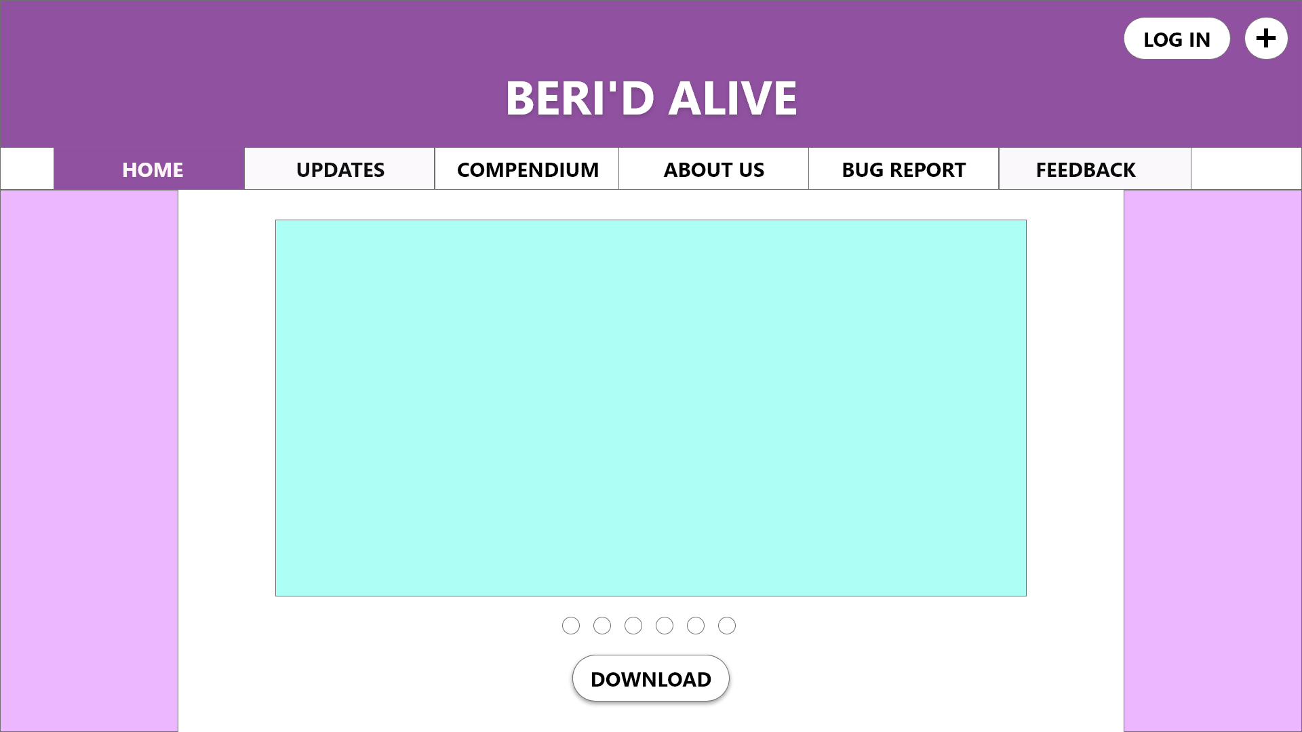
Home Page
First Page
Download

Slide 7
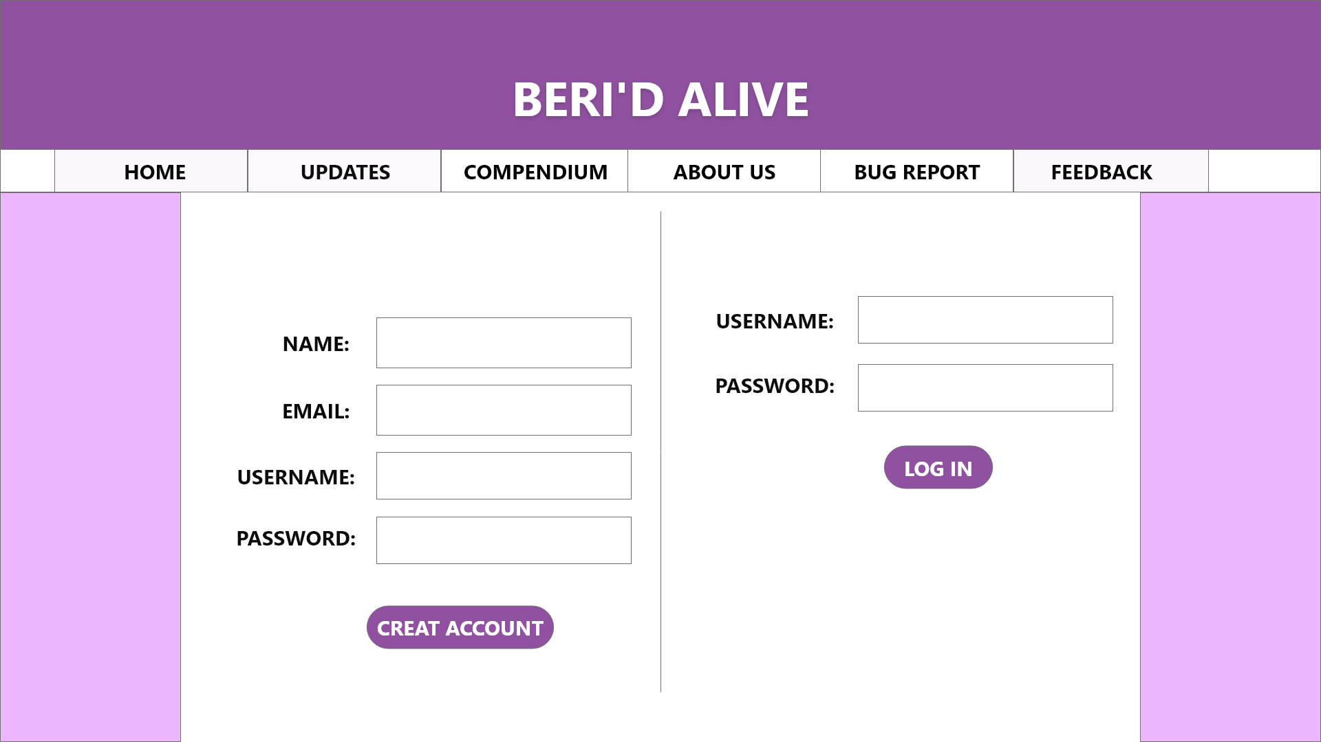
Log In/Create Account Page

Slide 8
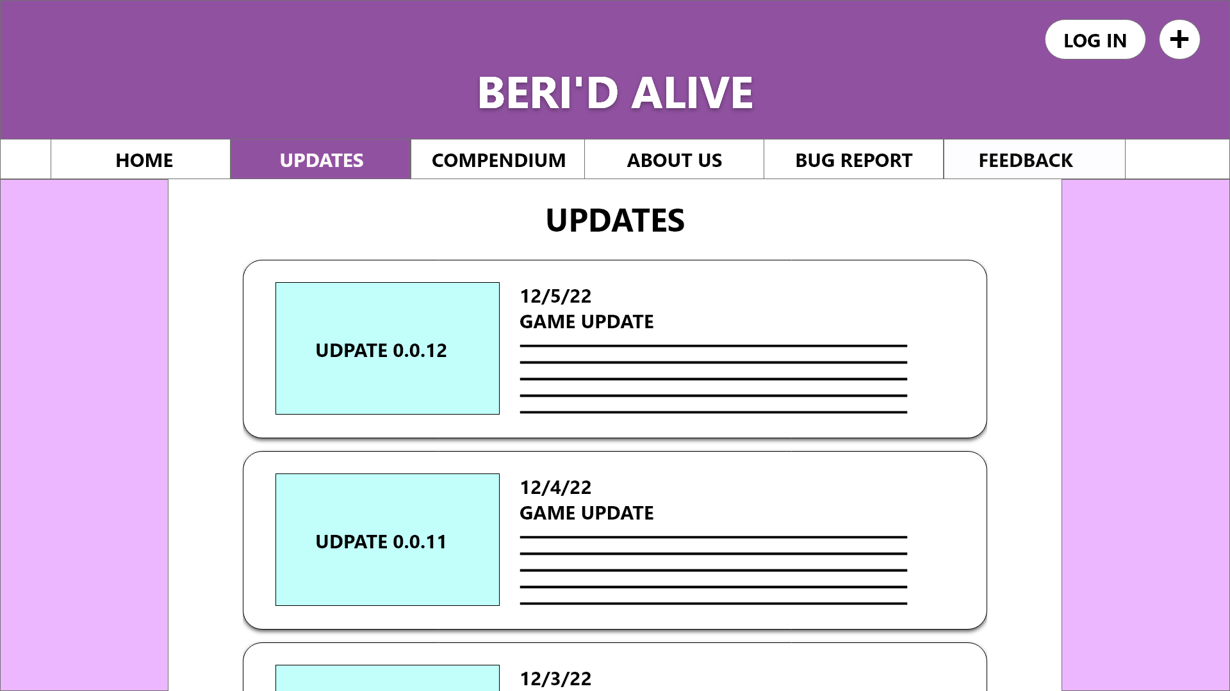
Updates Page
Updated version of game
What is new in this version.

Slide 9
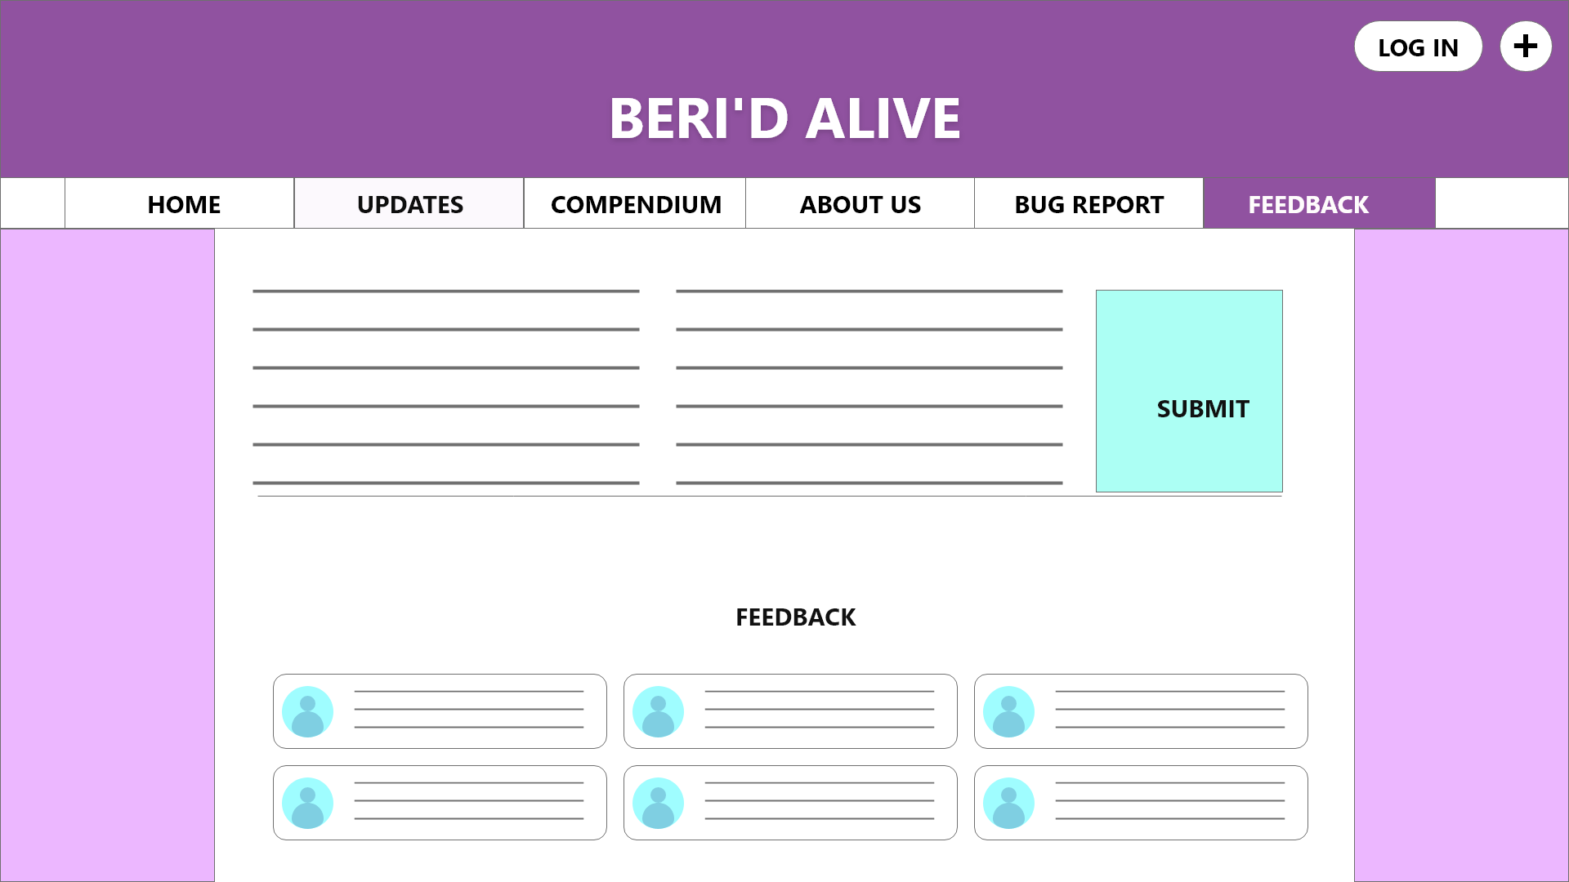
Feedback Page
Reviews and Feedbacks from users
Answers from Developers

Slide 10
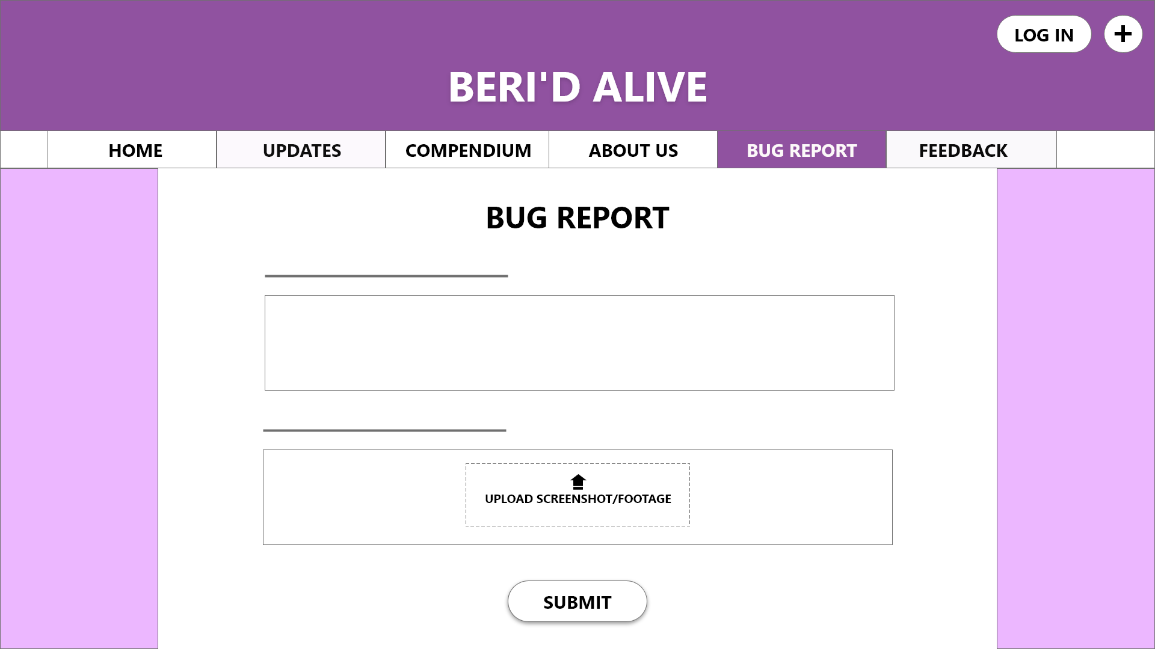
Bug Report Page

Slide 11
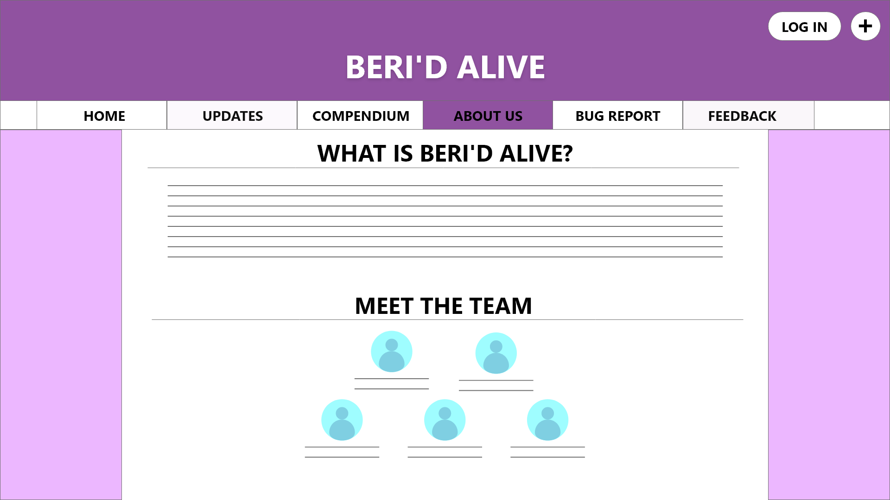
Developer’s Introduction Page

Slide 12
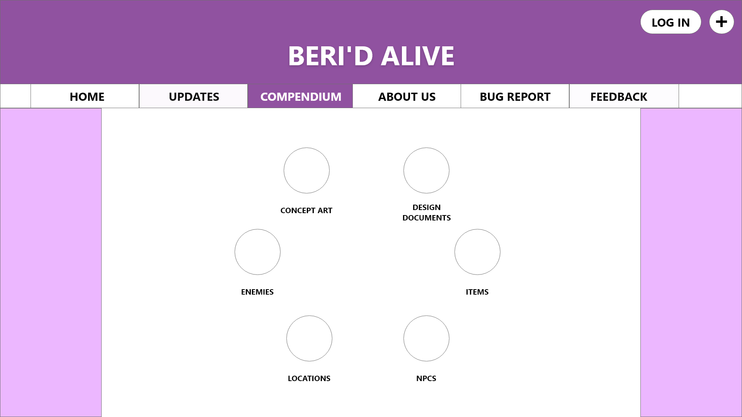
Compendium Page
NCP
Enemies
Concept art
Design Documents
Locations

Slide 13
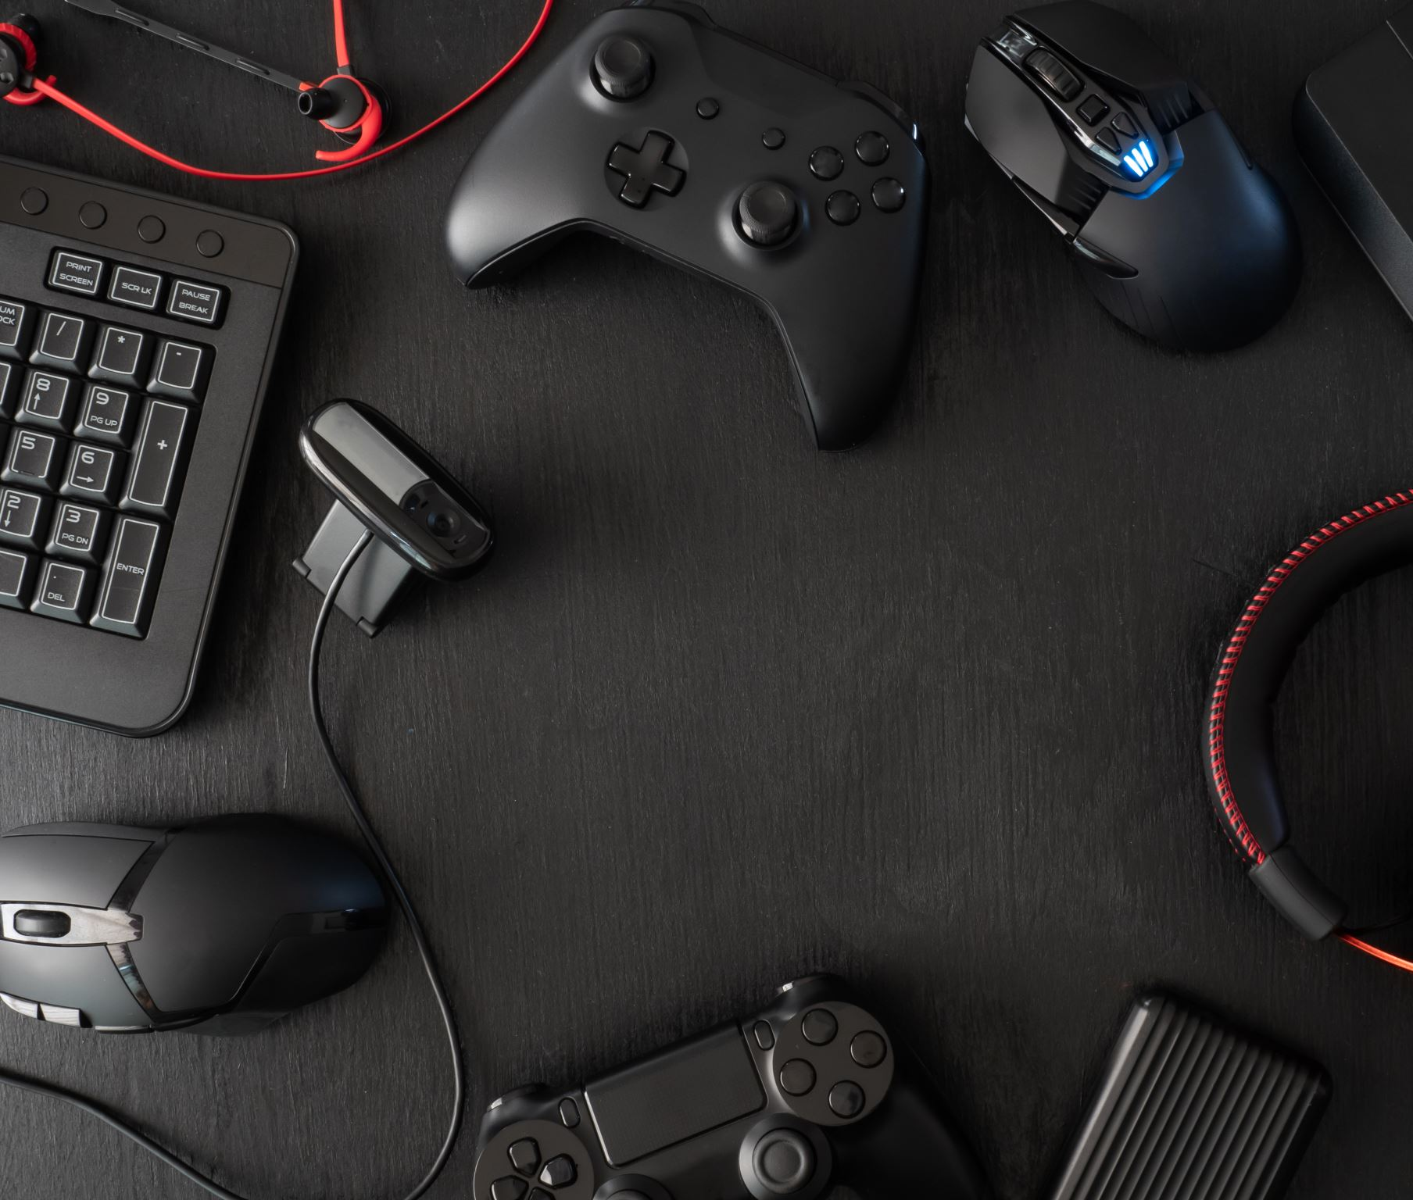
Conclusion
Project divided into two parts
Video Game
Website
It has 7 different pages
Easy to understand GUI
Thank You!!

